Slide 1
BTP Presentation
Himanshu
18ME10024

Slide 2
Introduction
The Project consists of 3 Sections:
Creating a model for Detection of COVID-19 using Cough Recordings
Creating an App for implementing the Model
Comparison of First and Second Wave of COVID – 19

Slide 3
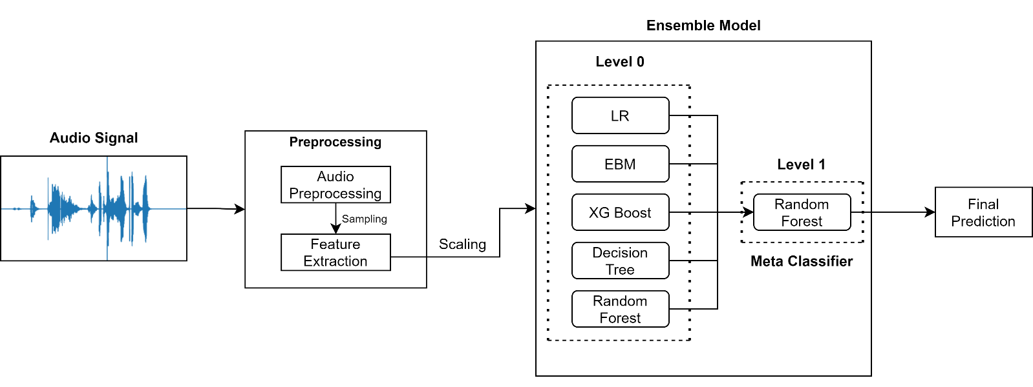
Introduction
Creating a COVID – 19 Cough Classifier using Machine Learning Techniques
Notes:
COVID-19 was first identified on January 2020 in Wuhan, China; since then, much technological advancement is already in place to identify COVID-19 patients.
Here,I present a COVID-19 cough classifier that would help in contactless detection of COVID-19 patients by analysing their audio cough samples. The report demonstrates five machine learning classification models and combines those models into an ensemble model with 25 dominant features. The proposed method has been examined on both COVID-19 positive and healthy individuals' cough recordings. The results are promising, scoring accuracy of 99.3%, a sensitivity of 99% on validation data with an Area under the ROC curve of 0.97, all while maintaining interpretability.

Slide 4
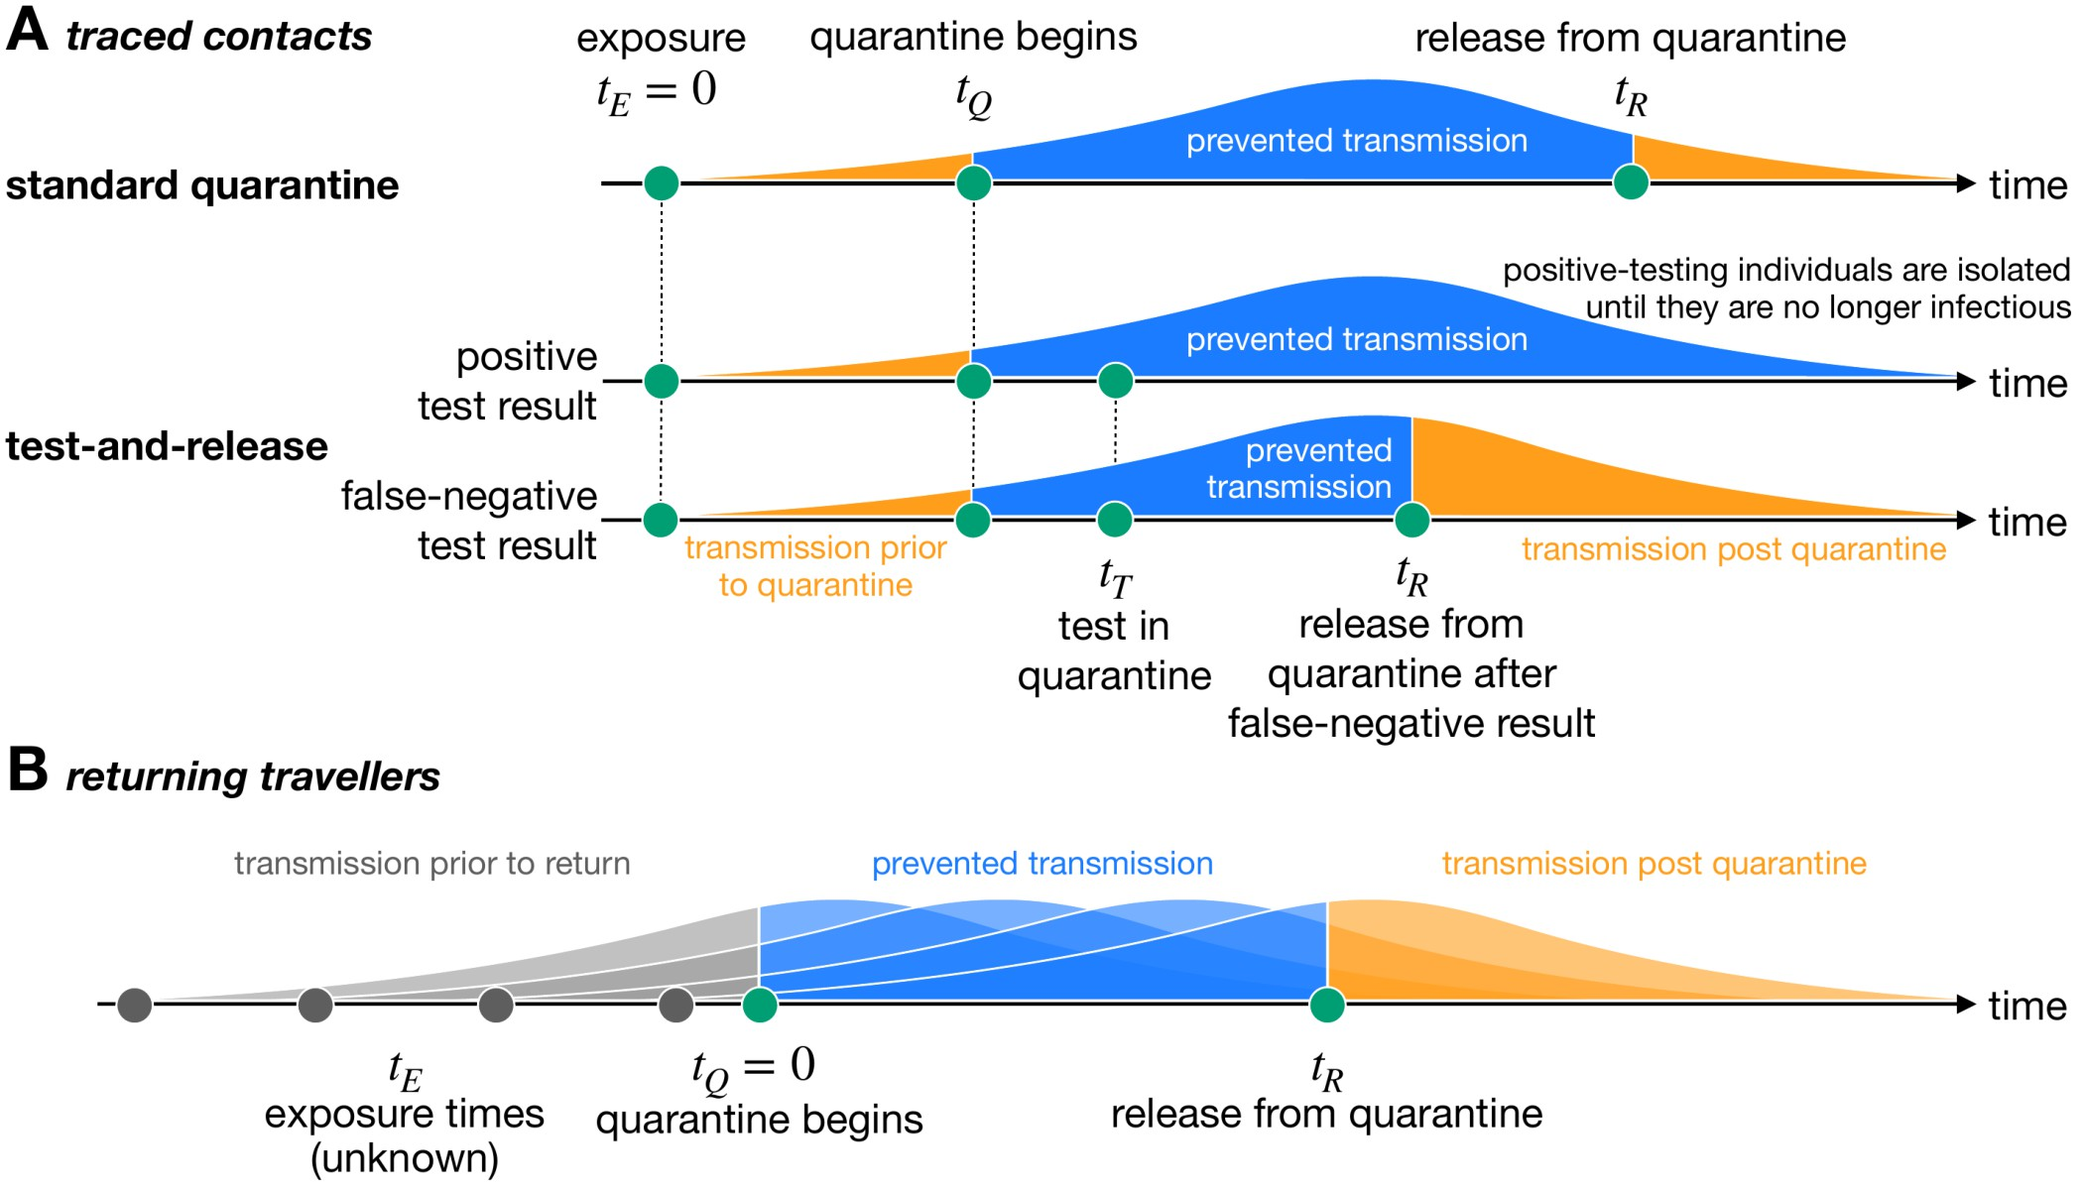
Motivation and Existing Solution
Increased rate of Testing has led to significant prevention in transmission of COVID 19
Frequent Testing can be really affective at catching COVID – 19 infections and potentially blocking transmission
Existing Solution: RTPCR Kits
Takes at least 24 hours to get results
Limited frequency of tests
Doesn’t account for new strains
Can be performed only by medical professionals
Notes:
Motivation and Existing solution: Studies have pointed out that Frequent COVID-19 testing is the key to efficient and early detection of COVID - 19(Pt 1 and 2). A study has even pointed out that Testing half the population weekly would drive the virus toward elimination within weeks – even if those tests are significantly less sensitive than clinical tests.
The image shown here shows the present scenario of how testing along with quarantine can potentially block transmission (even with false negative results):
1. Standard Quarantine + No Testing → here if the person is carrying the disease and is Asymptomatic, he will continue to transmit disease post quarantine
Now, with test results:
2. If a person has a positive test result, he will be isolated and hence the transmission is prevented.
3. If the test results is inaccurate and the person is wrongly detected as covid negative, keeping him in isolation till the test results will also lead to prevention in transmission.
The current testing method RTPCR has certain disadvantages as listed here:
1.
2.
3.
4.
Researchers say that when it comes to public health, it's better to have a less sensitive test with results today than a more sensitive one with results tomorrow(https://www.business-standard.com/article/current-affairs/frequent-rapid-testing-can-cripple-coronavirus-within-weeks-study-120112300270_1.html), Frequent Testing: https://www.journalofhospitalinfection.com/article/S0195-6701(21)00287-5/fulltext

Slide 5
Problem Statement
Can we make a COVID-19 detection method which:
Can give accurate test results in relatively less time?
Can be performed more frequently (hourly/daily)?
Can detect New Strains?
Can be performed without Medical Assistance?
Can be cheaper than RTPCR?
Notes:
The Existing solution which is the RTPCR has certain disadvantages as discussed in the previous slide, I try to address these questions in my COVID Detection model.
(The first Q is) 1. can we get accurate test results with reduced waiting time
2. Currently, experts have suggested that RTPCR tests be taken after a gap of at least 14 days. Here the question is Can we propose a method using which we can conduct tests more frequently? This can significantly bring down transmission as the potentially infected person can immediately isolate or get treated after he is diagnosed as covid positively.
3. New Strains of COVID 19 are not detected by RTPCR, can it be detected in any way?
4. Is there a way to perform the tests without having to visit testing centres or without any medical supervision?
5. RTPCRs are very costly with their price ranging from Rs 500 to 1500. Can we have tests which are more cost effective?
Source: https://health-desk.org/articles/how-many-days-after-exposure-should-one-be-tested-to-yield-the-most-accurate-results-and-with-which-test

Slide 6
Literature Review
In recent years, studies have suggested the use of acoustic features for identifying respiratory diseases in cough signals
Several studies have used Machine Learning techniques to process respiratory data and cough sounds
Researchers have also found some alteration in frequency characteristics of sound due to presence of COVID-19 in the lungs
Certain metrics like MFCCs(Mel Frequency Cepstral Coefficients), Zero Crossing Rate, Spectral Centroid have become state-of-the-art features to extract information out of sounds
Techniques like Deep Learning, Hidden Markov Models, Support Vector Machines have been used to detect cough sounds in voice recordings and to detect presence of COVID – 19 in cough sounds
Notes:
Pt 1.: This review attempts to summarize the vital studies in cough detection and identify diseases based on cough audio samples' features like frequency, duration, and intensity
Pt 2.:
Pt 3.:
Pt 4.: Which works on the sample principle of detecting the presence of certain frequency

Slide 7
Novelty
Usage of Interpretable Models and Libraries to understand the output of Individual Models
Usage of Ensemble learning to combine the output of these Models
Creation of Web Application for increasing the usability of the Model
Notes:
One More Point -- DONE

Slide 8
Methodology
Data Sources Used in the Project:
1279 Cough Recordings were obtained from The Indian Institute of Science, Bangalore and is available on GitHub
164 Cough Recordings were obtained from The University of Manchester and is available on Mendeley
Notes:
Dataset used to train my Machine Learning models have been obtained from two sources: IISc Bangalore and The University of Manchester
Here you can see the distribution of COVID Positive and COVID Negative cough Recording.
Researchers say that COVID-19 has a different response with respect to the country's geographical location; hence, I have given more emphasis to collecting data from Indian resources to make the model more relevant for this climatic condition.
CEBM: https://www.cebm.net/covid-19/effect-of-latitude-on-covid-19/

Slide 9
Methodology
Cough sound carries underutilized respiratory health information
COVID-19 influences the lower respiratory system in a distinctive way
Comparing COVID-19 and Non-COVID-19 patients’ cough recordings will help us differentiate and detect COVID-19 patients
Machine Learning techniques can be used to discover hidden patterns in COVID-19 cough sounds
Notes:
Now that we have the data, we need to understand why we are taking this approach to detect COVID-19. Hence we need to Before understanding how the features were extracted, we need to understand 1. Why we are taking this approach? and 2. Why we are extracting these features?
Pt 1.: Studies have reported that Cough sound contains vital underutilised respiratory health info, which can be used for analysis
Pt 2.: Methods like X-rays and Chest CT scans have been used to identify COVID-19 patients, these methods have suggested that the COVID-19 influences the LRS in a distinctive way
Pt 3.: Capturing and comparing the time-varying characteristics would help us reveal important patterns/differences in COVID-19 and Non-COVID-19 cough sounds
Pt 4.: Comparing such huge numerical database is not possible manually, hence machine learning techniques are used for the finding the hidden patterns in cough sounds
COVERED -- Extra Pt: These minor differences can not be manually processed hence we can use Machine Learning for the comparison
- Before applying the machine learning techniques we need to convert the cough sound waves from analog signal to a digital signal
-* Cough Sound recordings are analog signals and need to be converted to digital signals for further processing

Slide 10
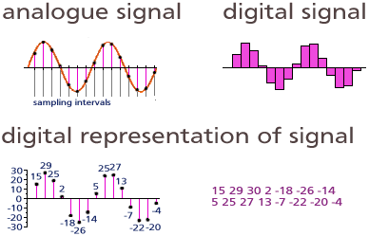
Analog Digital Converter (ADC):
Analogue Signal → Digital Signal → Digital Representation of the obtained points → Array of numbers
Here the Sampling Rate is fixed to 22050 Hz for all cough samples
This process is performed using Python’s Librosa Library
Notes:
-** Analog Digital Conversion (ADC) consists of 3 steps → Sampling ,Quantization and Encoding
Sampling: Here we try to freeze the signal, this is done by taking samples of the wave after a specified time interval (The inverse of this interval is called sampling rate), this is shown under Analogue signal
Quantization: - After sampling we have a discrete time continuous valued signal, this signal is then converted to discrete time discrete valued signal using quantization.
- Here the reference signal is partitioned into several discrete quanta and then the input signal is matched with the correct quantum. This is shown under digital signal.
Encoding: Here; for each quantum, a unique digital code will be assigned and after that the input signal is allocated with this digital code. These digital codes are stored in form of an array as shown on the right under digital representation of signal

Slide 11
Feature Extraction :
COVID-19 is said to cause inflammation of the upper airway and larynx
This inflammation affects the flexibility of the vocal cords hence cause minor alterations in frequency
25 time-frequency features are extracted from each cough audio sample to observe these alterations
Here 5 of the features are mean of instantaneous frequency peaks of each audio wave
Rest 20 features are Mel Frequency Cepstral Coefficients (MFCCs)
Notes:
WHY FEATURES --Now that we have the cough audio signals in digital format we need to identify which features to extract in order to obtain maximum spectral information in the cough.
Studies have found that COVID causes inflammation in upper airway and larynx which alters the flexibility of Vocal cords hence affecting the frequency of cough sounds
These time-frequency features are extracted to understand the frequency alterations due to presence of COVID-19 and use this principle to build our Machine Learning Model

Slide 12
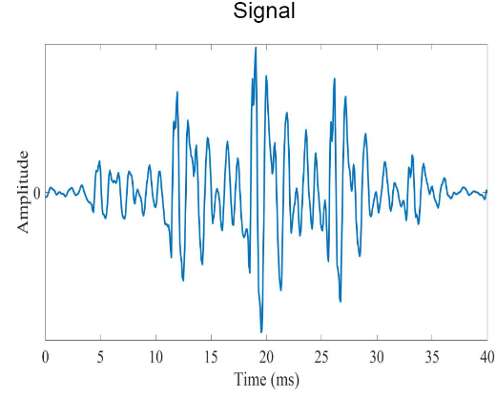
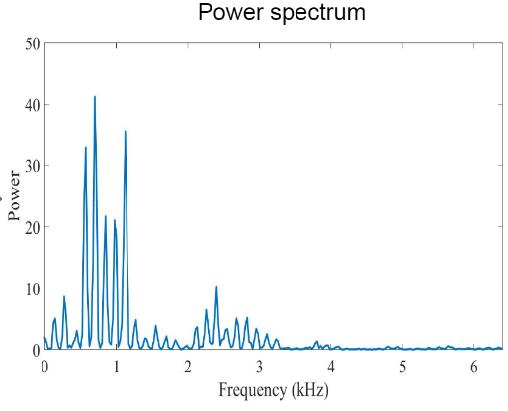
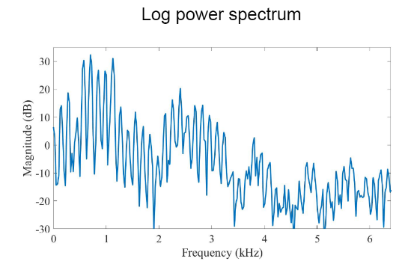
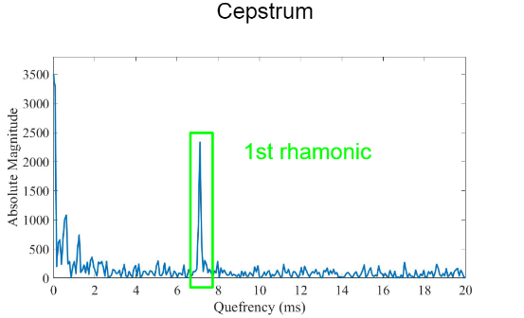



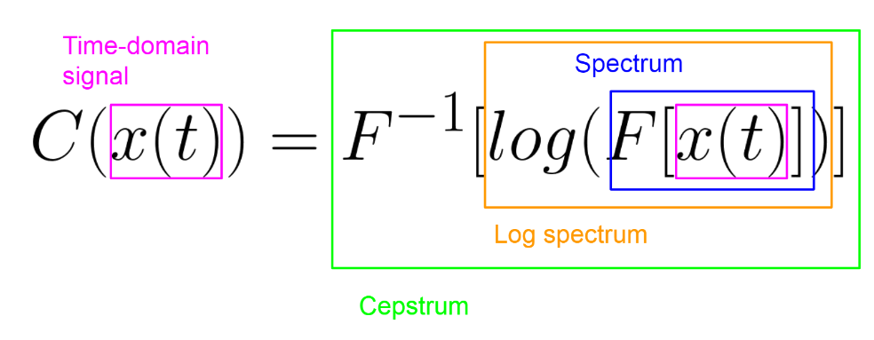

Mel Frequency Cepstral Coefficients (MFCCs) :
MFCC of a signal are a set of features which reveals the variation of the signal’s frequency content as time evolves
Extraction Process:
DFT → Discrete Fourier Transform
IDFT → Inverse DFT
$$Magnitude(dB)=10log⁡\left(\frac{Power}{{Power}_{0}}\right)$$
Notes:
HOW FEATURES – MFCC
I will now explain how MFCC are extracted from the cough sound
Firstly, STFT is applied on the digital signal of cough sound,
STFT uses a sliding window function $g(t)$ centred at time $τ$ to consecutively perform ‘time localised Fourier transform of the signal $x(t)$. The result reveals that the variation of the signal’s frequency content as time evolves.

Slide 13
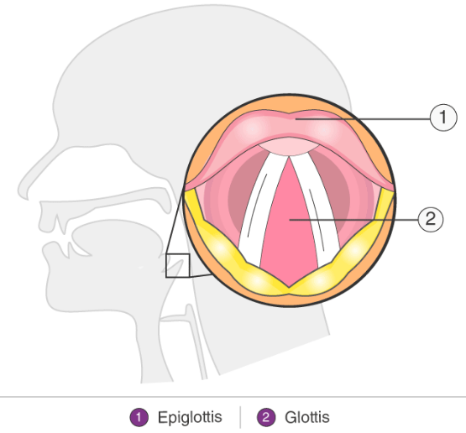
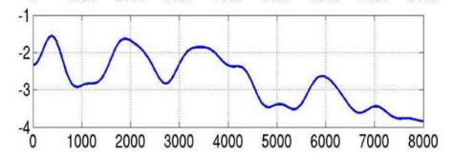
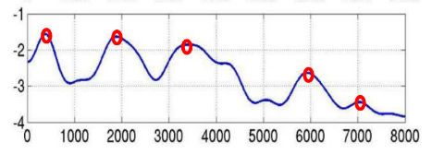
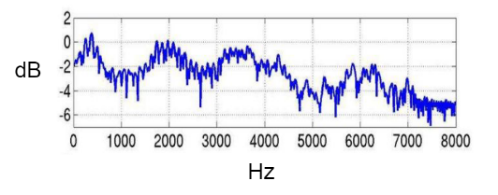
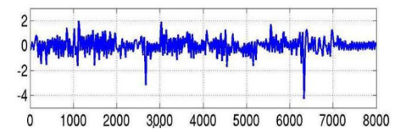
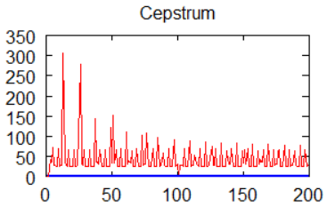
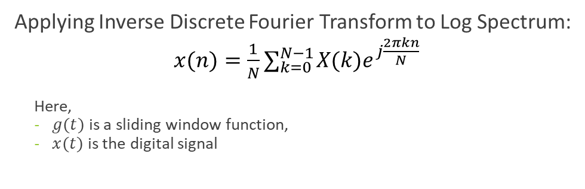
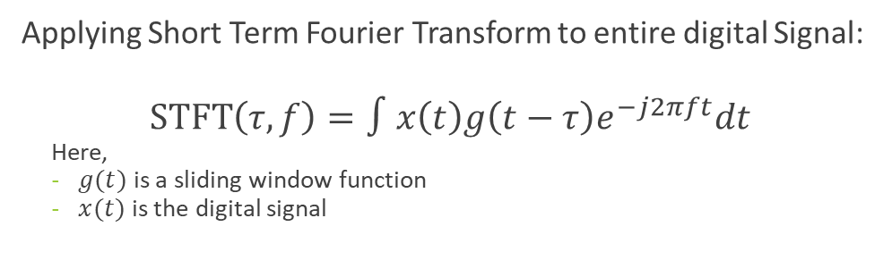

Mel Frequency Cepstral Coefficients (MFCCs) :
Log Spectrum due to Vocal Tract
Log Spectrum of portion of signal
IDFT
Vocal Tract
Glottis
Log Spectrum due to Glottal Pulse
First 20 Features are the required MFCCs
Applying Short Term Fourier Transform to entire digital Signal:
$$\operatorname{STFT}\left(τ,f\right)=∫x\left(t\right)g\left(t−τ\right)e^{−j2πft}dt$$
Here,
$g(t)$ is a sliding window function
$x(t)$ is the digital signal
Applying Inverse Discrete Fourier Transform to Log Spectrum:
$x(n)=\frac{1}{N}∑_{k=0}^{N−1} X(k)e^{j\frac{2πkn}{N}}$
Here,
$g(t)$ is a sliding window function,
$x(t)$ is the digital signal
$$DFT →X(k)=∑_{n=0}^{N−1} x(n)e^{−j\frac{2πkn}{N}}$$
Notes:
HOW FEATURES – MFCC
The Log spectrum graph obtained in the previous slide can be divided into 2 parts, one is due to.
COVID-19 alters the flexibility of vocal cords
The frequency of these peaks carries the identity of the cough hence is able to distinguish between COVID and Non- COVID cough
Now, After applying the IDFT, we obtain the occurrences (get the frequency) of different peaks present in the log spectrum graph
Y-value corresponding to the first 20 coordinates on X-axis are the first 20 MFCCs of that portion of cough signal
The mean of these 20 MFCCs of all the portions of the cough signal represents the first 20 MFCCs of the entire cough
The method of applying the DFT to small portion of cough signal is performed by applying STFT to the entire signal

Slide 14
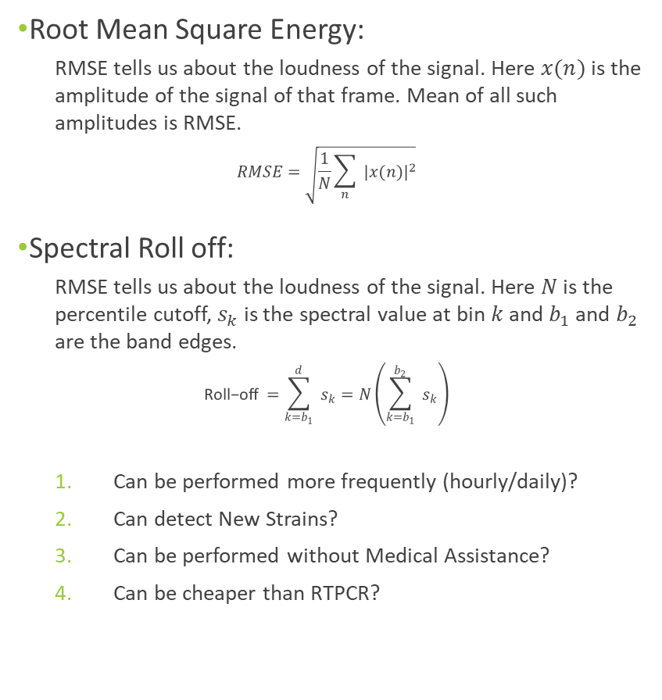
Root Mean Square Energy:
RMSE tells us about the loudness of the signal. Here $x(n)$ is the amplitude of the signal of that frame. Mean of all such amplitudes is RMSE.
$$RMSE=\sqrt{\frac{1}{N}\sum_{n}{ }|x(n)|^{2}}$$
Spectral Roll off:
RMSE tells us about the loudness of the signal. Here $N$ is the percentile cutoff, $s_{k}$ is the spectral value at bin $k$ and $b_{1}$and $b_{2}$ are the band edges.
$$\text{Roll}\text{−}\text{off} =\sum_{k=b_{1}}^{d}{ }s_{k}=N\left(\sum_{k=b_{1}}^{b_{2}}{ }s_{k}\right)$$
Can be performed more frequently (hourly/daily)?
Can detect New Strains?
Can be performed without Medical Assistance?
Can be cheaper than RTPCR?
Can we make a COVID-19 detection method which:
Can give accurate test results in relatively less time?
Can be performed more frequently (hourly/daily)?
Can detect New Strains?
Can be performed without Medical Assistance?
Can be cheaper than RTPCR?
Notes:
HOW FEATURES
RMSE: Root Mean Square Energy’s magnitude is the energy of the signal. It tells us about the loudness of the audio signal. RMSE is the square root of the mean square (the average of the squares of the magnitude of the audio frames). We take the mean of all such amplitudes.

Slide 15
Can we make a COVID-19 detection method which:
Notes:
HOW FEATURES - MFCC

Slide 16
Notes:
WHAT MODELS

Slide 17
Notes:
WHAT MODELS

Slide 18
Notes:
ENSEMBLE MODELS

Slide 19
Notes:
RESULTS

Slide 20
Notes:
APP

Slide 21
Notes:
APP

Slide 22
Notes:
COVID 1ST AND 2ND WAVE COMPARISON

